Slide 1
AWS(Amazon Web Services)
P.V.Poojitha
20A31A4222

Slide 2
Amazon EC2
Here are the step-by-step instructions to create an instance on Amazon EC2:
Task 1: Launch Your Amazon EC2 Instance
In the AWS Management Console choose Services, choose Compute and then choose EC2.choose launch instance.
Give the instance the name Web Server.
In the list of available Quick Start AMIs, select Amazon Linux AMI .
In the Instance type panel, keep the default t2.micro selected.
For Key pair name, choose vockey or create your own key pair.
In the network settings select vpc as Lab-vpc.
Under Firewall create a security with security group name and give description.
For Termination protection, select Enable.
Launch the EC2 instance.

Slide 3
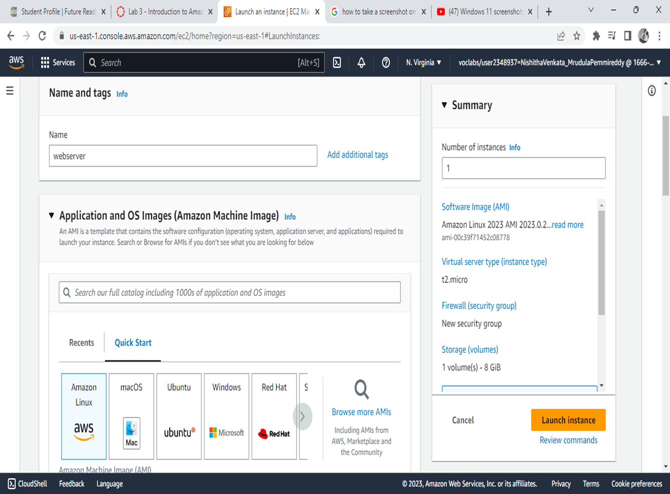

Slide 4
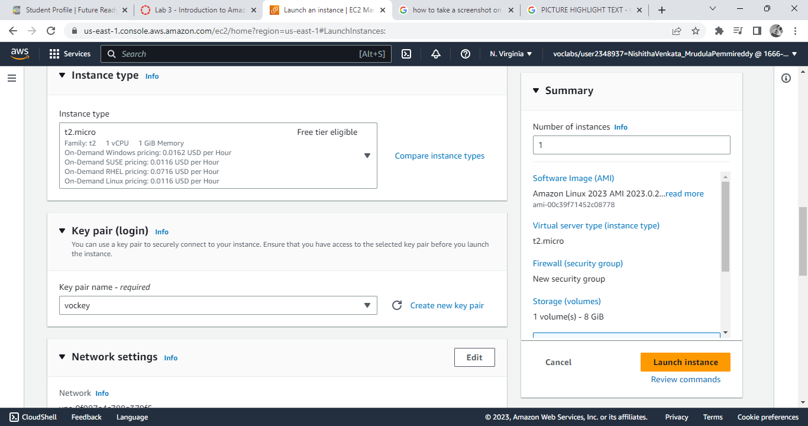

Slide 5
Task 2: Update Your Security Group
On the EC2 Console tab,in the left navigation pane, choose Security Group
Select Web Server security group
Choose Edit inbound rules, select Add rule and then configure:
Type: HTTP
Source: Anywhere-IPv4
Choose Save rules

Slide 6
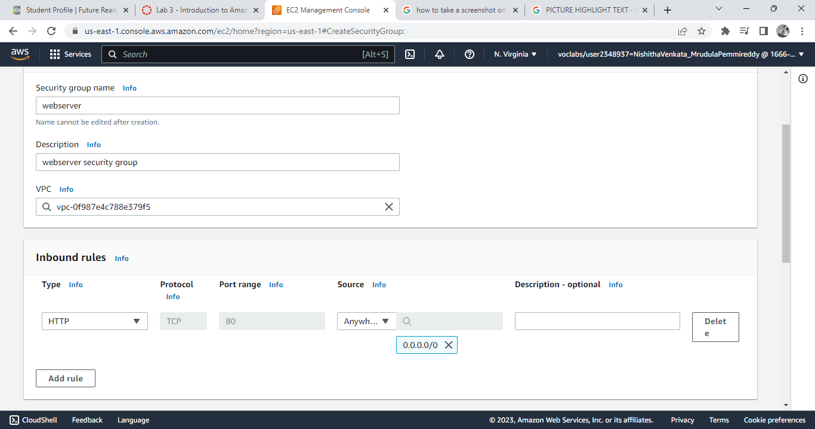

Slide 7
Amazon IAM
1.Exploring pre-created IAM Users and Groups:
a. Log in to your AWS Management Console and navigate to the IAM service.
b. Click on "Users" in the left navigation menu to view the list of IAM users created by default.
c. Click on "Groups" in the left navigation menu to view the list of IAM groups created by default.
d. Explore the different IAM users and groups to understand their roles and permissions.
2.Inspecting IAM policies as applied to the pre-created groups:
a. Select one of the pre-created groups to view its details.
b. Click on the "Permissions" tab to view the policies that are applied to the group.
c. Click on a policy to view its details and understand its permissions.
3.Following a real-world scenario, adding users to groups with specific capabilities enabled:
a. Identify the group that has the necessary permissions for the specific capabilities you require.
b. Navigate to the "Users" tab in the IAM console and click "Add user".
c. Follow the prompts to create a new IAM user with the necessary permissions and select the appropriate group.
d. Repeat this process for any additional users that require the same permissions.

Slide 8
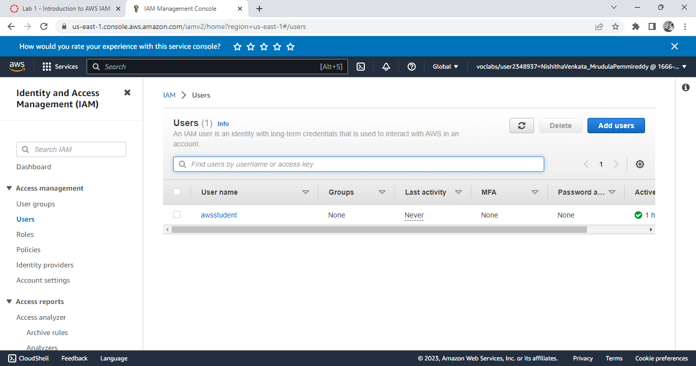

Slide 9
4.Locating and using the IAM sign-in URL:
a. In the IAM console, click on "Dashboard" in the left navigation menu.
b. Locate the "IAM users sign-in link" under "Access Advisor".
c. Copy the link and distribute it to your IAM users as necessary.
5.Experimenting with the effects of policies on service access:
a. Select a user or group to experiment with.
b. Click on the "Permissions" tab and select a policy that has restricted permissions for a specific AWS service.
c. Attempt to access the restricted service as the selected user or group and observe the resulting access denied error.
d. Modify the policy to grant access to the restricted service and attempt to access it again to confirm that access has been granted

Slide 10
Cloud Watch
The step-wise instructions to create Amazon CloudWatch alarms and monitor the performance of your infrastructure:
1. Open the Amazon CloudWatch console:
Log in to your AWS account and navigate to the CloudWatch service console.
2. Create a new metric filter:
Click on the "Log groups" option from the left navigation pane, then select the log group you want to monitor. Click the "Create Metric Filter" button and provide a filter pattern that identifies the log events you want to monitor.
3. Choose a metric and create an alarm:
After the filter is created, CloudWatch will begin collecting data that matches your filter pattern. Navigate to the CloudWatch Metrics tab and select the metric you want to monitor. Click the "Create Alarm" button to configure the alarm.

Slide 11
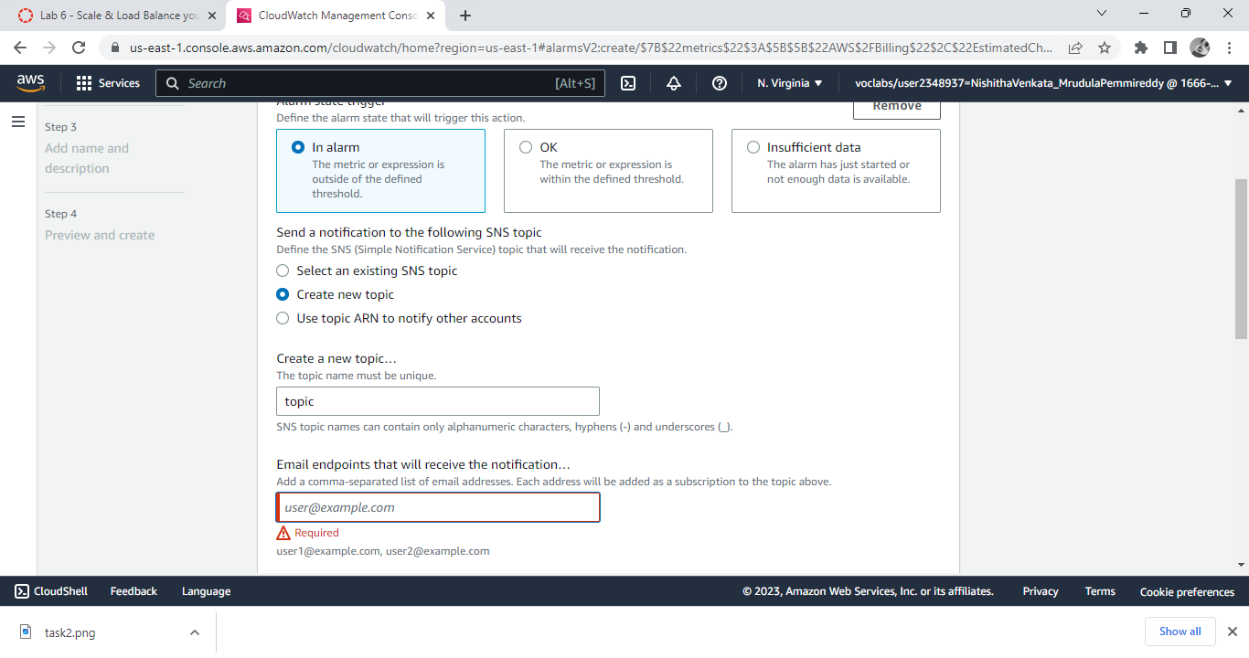

Slide 12
4. Set alarm threshold and actions:
Set the alarm threshold that triggers the alarm and configure the actions that should be taken when the alarm is triggered. You can choose to send a notification, run an AWS Lambda function, or take other actions.
5. Review and confirm the alarm settings:
Review the settings for the alarm and click the "Create Alarm" button to confirm the configuration.
6. Monitor the alarm:
You can monitor the status of your alarm by navigating to the "Alarms" tab in the CloudWatch console. From there, you can see the status of your alarms, manage the actions taken when an alarm is triggered, and view alarm history.
7.Modify or delete the alarm:
If you need to modify or delete an alarm, simply select the alarm you want to modify or delete from the "Alarms" tab in the CloudWatch console and make the necessary changes.
That's it! By following these steps, you can create Amazon CloudWatch alarms and monitor the performance of your infrastructure.

Slide 13
Build your VPC and Launch a web server
The step-wise instructions to create a VPC and launch an EC2 instance into a VPC:
Create a VPC:
a. Log in to the AWS Management Console.
b. In the top navigation bar, select the region where you want to create your VPC.
c. Go to the VPC dashboard and click on the "Create VPC" button.
d. Provide a name and CIDR block for your VPC.
e. Click on the "Create VPC" button.
2. Create Subnets:
a. Go to the VPC dashboard and click on the "Subnets" option in the left-hand menu.
b. Click on the "Create Subnet" button.
c. Provide a name, VPC, and CIDR block for your subnet.
d. Click on the "Create" button.

Slide 14
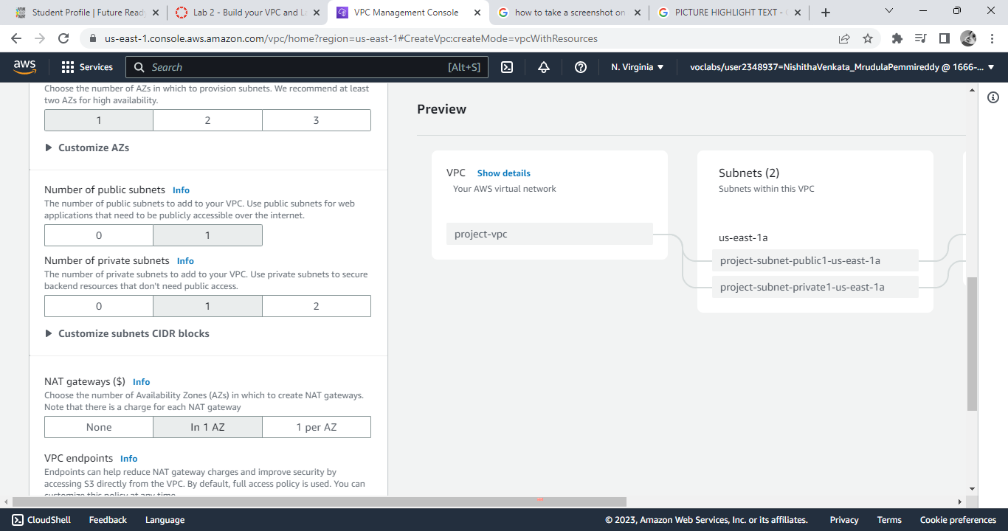

Slide 15
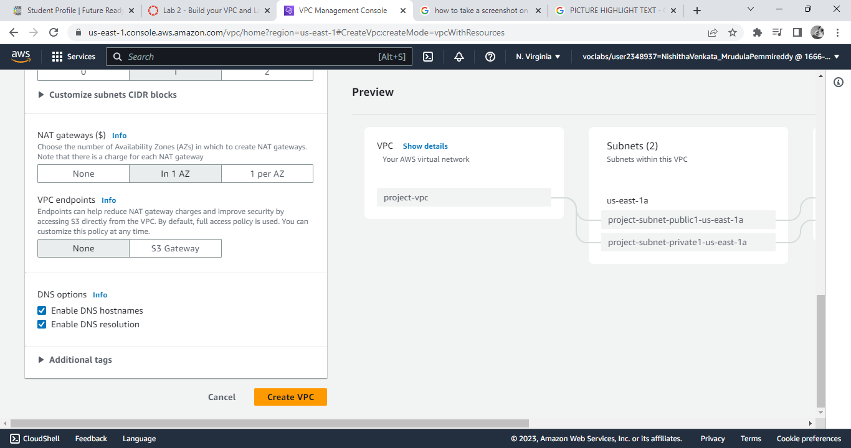

Slide 16
3. Configure a Security Group:
a. Go to the EC2 dashboard and click on the "Security Groups" option in the left-hand menu.
b. Click on the "Create Security Group" button.
c. Provide a name and description for your security group.
d. Add rules for inbound and outbound traffic.
e. Click on the "Create" button
4. Launch an EC2 Instance into a VPC:
a. Go to the EC2 dashboard and click on the "Launch Instance" button.
b. Choose an Amazon Machine Image (AMI) for your instance.
c. Choose an instance type.
d. Configure the instance details such as VPC, subnet, and security group.
e. Add storage if necessary.
f. Configure any additional details such as user data and tags.
g. Review and launch the instance.

Slide 17
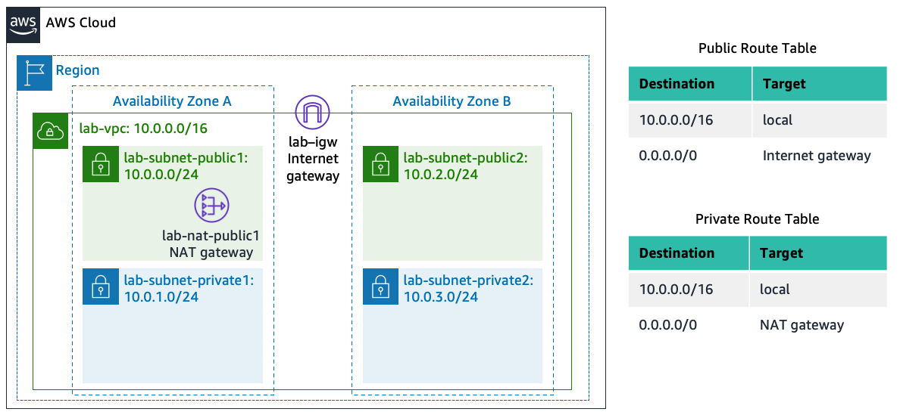

Slide 18
h. Select a key pair to connect to the instance.
i. Click on the "Launch Instances" button
Once your instance is launched, you can connect to it using the key pair you selected during the launch process.

Slide 19
Elastic Load Balancer
In the left navigation pane, click Load Balancers.
At the top of the screen, choose
Under Application Load Balancer, choose Create
Under Load balancer name, enter: LabELB
Scroll down to the Network mapping section, then:
For VPC, select: Lab VPC
select Public Subnet 1 in 1st az
select Public Subnet 2 in 2nd az
choose the Security groups drop down menu and select Web Security Group
For the Listener HTTP:80 row, set the Default action to forward to LabGroup.
Scroll to the bottom and choose Create load balancer

Slide 20
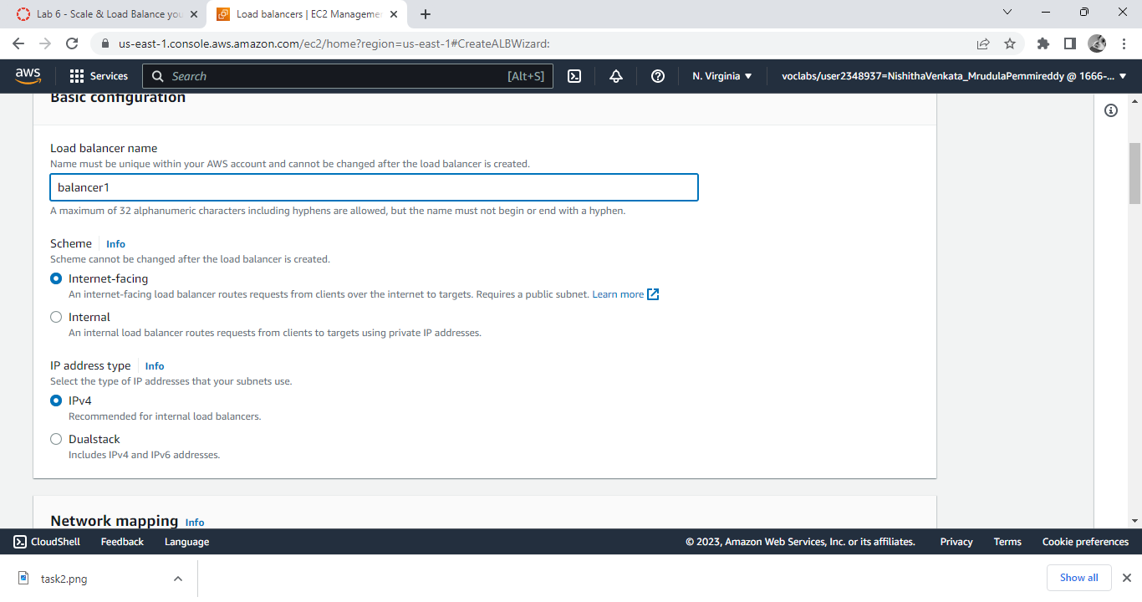

Slide 21
Amazon EBS
Task 1: Create a New EBS Volume
In the AWS Management Console, on the Services menu, click EC2.
Choose Create volume then configure:
Volume Type: General Purpose SSD (gp2)
Size (GiB): 1
Availability Zone: Select the same availability zone as your EC2 instance.
Choose Add Tag
In the Tag Editor, enter:
Key: Name
Value: My Volume
Choose Create Volume

Slide 22
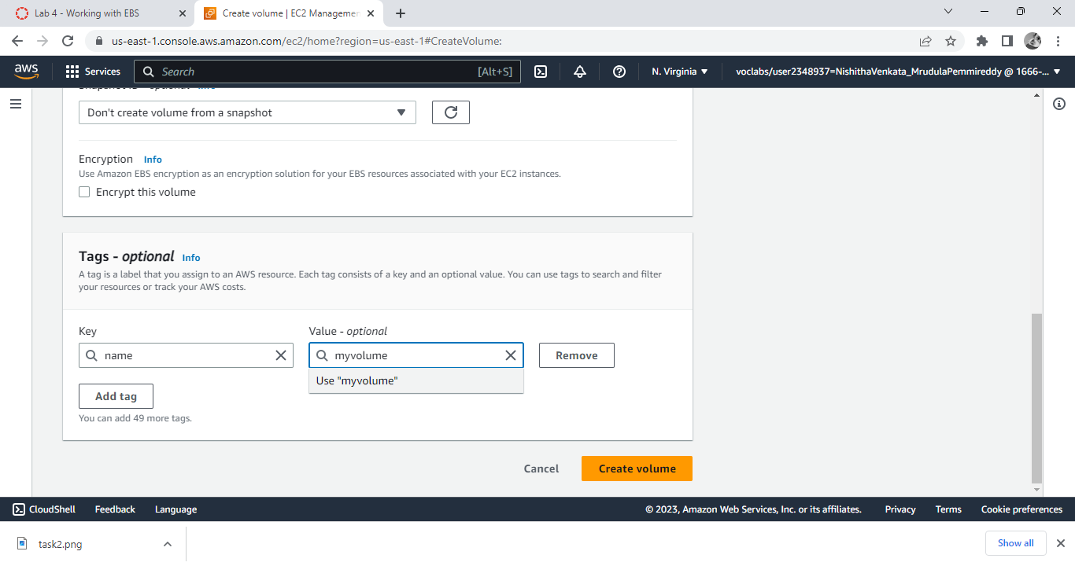

Slide 23
Task 2: Create an Amazon EBS Snapshot
In the AWS Management Console, choose Volumes and select My Volume.
In the Actions menu, select Create snapshot.
Choose Add tag then configure:
Key: Name
Value: My Snapshot
Choose Create snapshot

Slide 24
Amazon EBS
Task 1: Create a New EBS Volume
In the AWS Management Console, on the Services menu, click EC2.
Choose Create volume then configure:
Volume Type: General Purpose SSD (gp2)
Size (GiB): 1
Availability Zone: Select the same availability zone as your EC2 instance.
Choose Add Tag
In the Tag Editor, enter:
Key: Name
Value: My Volume
Choose Create Volume

Slide 26
Task 2: Create an Amazon EBS Snapshot
In the AWS Management Console, choose Volumes and select My Volume.
In the Actions menu, select Create snapshot.
Choose Add tag then configure:
Key: Name
Value: My Snapshot
Choose Create snapshot

